Slide 1

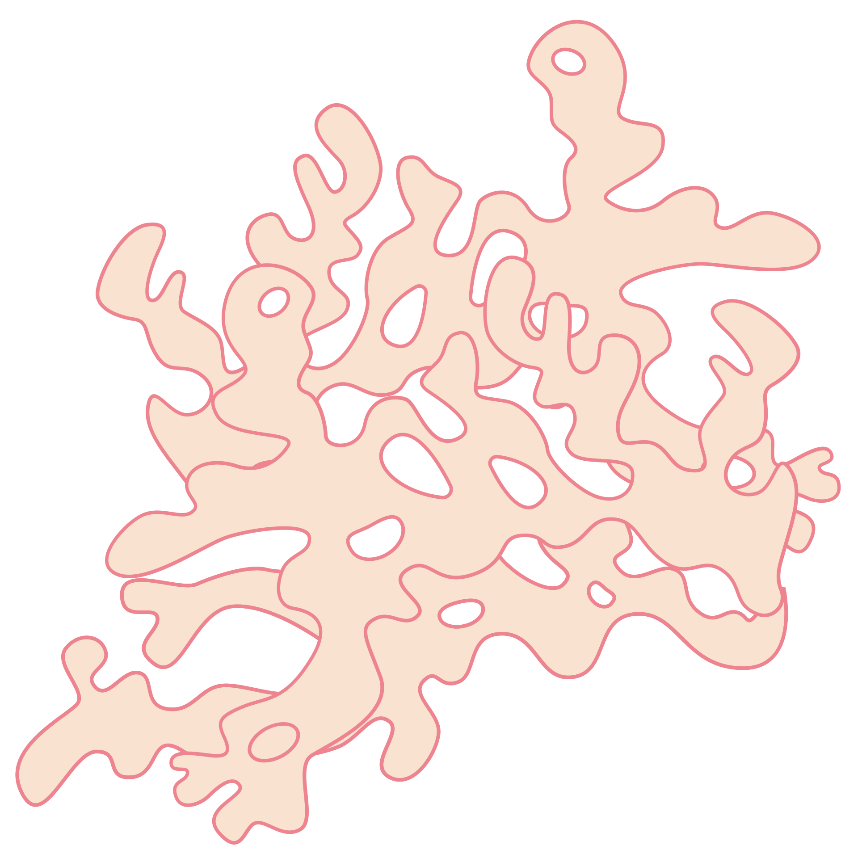




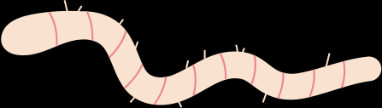
Donate Organs
Save Lives
ORGAN
BANK
Presented By :
DONA JINCE
MAC23MCA-2024
Project Guide:
NISHA MARKOSE

Slide 2
Introduction
The Organ Bank is an android application designed to streamline the process of organ donation and transplantation.
This platform connects donors, recipients, and hospitals through a centralized database, facilitating efficient organ allocation and management.

Slide 3


INTRODUCTION
FUNCTIONALITIES
DONATE ORGANS
SAVE LIVES
OBJECTIVES
TECHNOLOGY
CONTENTS
ACTORS
RELEVANCE

Slide 4

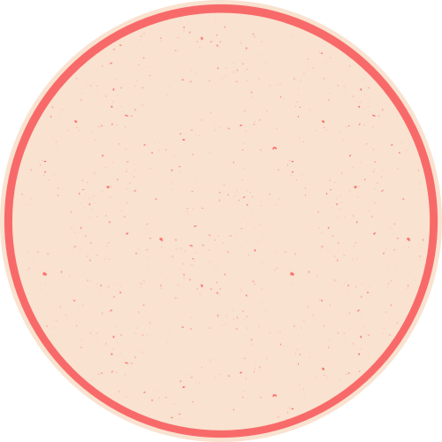

Objectives
Encourage Organ Donation:
Simplify registration to motivate individuals to donate organs and raise awareness about its importance.
Transparency:
Build trust through a transparent organ allocation process and real-time updates.
Centralized Management:
Provide a single platform to connect donors, recipients, and hospitals for effective organ donation and transplantation.
Automated Matching:
Use compatibility criteria (e.g., blood type, urgency, organ type) to ensure fair and efficient organ allocation.
Real-Time Notifications:
Notify donors, recipients, and hospitals promptly about matches and updates in the system.

Slide 5



FUNCTIONALITIES
User Management:Verify and approve registrations of donors, recipients, and hospitals.
Data Validation:Ensure that all medical records and personal information submitted by users are accurate and complete.
System Monitoring:Monitor organ allocation processes to maintain fairness and transparency.
Database Maintenance:Manage and update the central database, including adding or removing records as necessary.
ADMIN
Reports and Analytics:Generate reports on organ availability, transplantation statistics, and donor-recipient trends.
Resolve Issues:Address any disputes or technical issues arising during system use.

Slide 6
FUNCTIONALITIES
Registration:Provide personal details, medical history, and the organs they wish to donate.
Profile Management:Update their information, such as address or medical status, as needed.
DONORS
Consent:Confirm their willingness to donate specific organs at the time of registration.
Notification Handling:Receive notifications if their donation is eligible for a recipient match or for updates regarding their donation status.

Slide 7
FUNCTIONALITIES
Registration:Submit a request for specific organs, along with their medical details and eligibility documents.
Profile Management:Update their health records or change organ request preferences if necessary.
RECEIPIENTS
Monitoring:Track the status of their request and receive notifications when a matching organ becomes available.
Medical Coordination:
Collaborate with their selected hospital to proceed with the transplantation process upon organ allocation.

Slide 8
FUNCTIONALITIES
Registration:Provide hospital details, including location, contact information, and areas of specialization.
Request Management:Submit requests for organs on behalf of their patients, specifying the type and urgency.
HOSPITALS
Medical Verification:Verify the compatibility of a donated organ with a recipient before proceeding with transplantation.
Procedure Updates:Update the system after successful transplants, including recipient recovery status and organ usage.

Slide 9
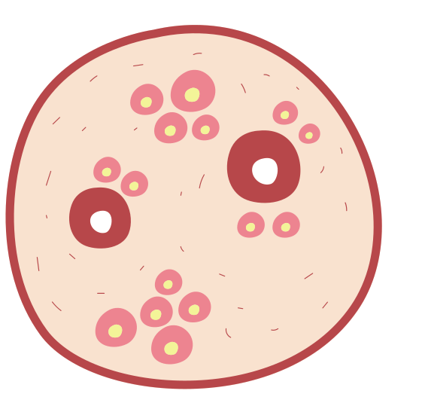
FRONTEND
BACKEND
FLUTTER
NODE JS
TECHNOLOGY
DATABASE
MONGODB

Slide 10
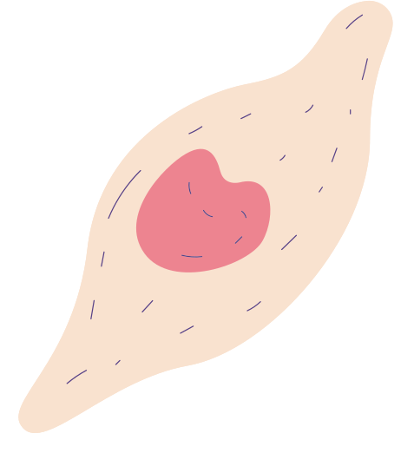


RELEVANCE
•Address the challenge of organ shortages and the inefficiencies in existing manual processes.
•By automating donor-recipient matching, providing real-time notifications, and maintaining secure medical records, the system reduces wait times and maximizes the utilization of available organs.
•it encourages more individuals to register as donors by ensuring transparency and building trust in the process.

Slide 11



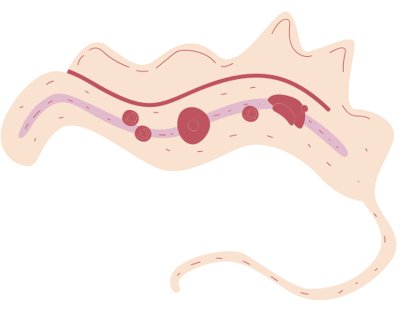
Thank you!

Slide 12

NODE JS

Slide 13
DATABASE INTEGRATION WITH NODE JS
1. Creating a Database Connection
2. Using DDL Commands in Node.js
Create a Table
Alter a Table
Drop a Table
Truncate a Table
3. Using DML Commands in Node.js
Insert Data
Update Data
Delete Data
Select Data
4. Executing the Commands
5. Example

Slide 14

EXISTING SYSTEM
Reliance on manual processes for organ donation and matching.
Delays in matching organs, causing long waiting times.
Communication gaps between hospitals, donors, and recipients.
No automation for compatibility checks or organ allocation.
Lack of transparency in organ matching and approval processes.

Slide 15
PROPOSED SYSTEM
Centralized database for donors, recipients, and hospitals.
Real-time notifications for organ match approvals and updates.
Seamless communication between admin, hospitals, donors, and recipients.
Efficient scheduling and management of compatibility tests.
Enhanced decision-making through reports and analytics.

Slide 16
ACTORS
ADMIN
RECEIPIENT
The admin oversees the entire system to ensure its smooth operation, ethical functioning, and data integrity.
Recipients are patients who need organ transplants.
DONORS
HOSPITAL
Donors are individuals who wish to donate their organs, either during their lifetime or posthumously.
Hospitals are authorized medical institutions that perform organ transplantation surgeries.

Slide 17
Roles
&
Responsibilities

Slide 18
Admin
·Verify donor, recipient, and hospital registrations.
·Oversees the automated organ matching system and reviews potential matches.
·Notifies donors, recipients, and hospitals about approved matches.
·Tracks organ availability and generates detailed reports.
·Monitors transplantation results and oversees feedback submissions.

Slide 19
Donor
·Registers with the system, providing consent for organ donation.
·Updates personal details and organ donation preferences.
·Receives notifications from the admin and hospital regarding matches, compatibility tests, and transplantation schedules.
·Provides feedback about the system and hospital services.

Slide 20
Receipient
·Registers with the system, requesting organ transplants.
·Updates personal details and organ requirements.
·Receives notifications about organ matches, compatibility tests, and transplantation schedules.
·Tracks organ match statuses and compatibility test results.
·Provides feedback about the system and hospital services.

Slide 21
Hospital
·Registers with the system and manages hospital-related data.
·Conducts compatibility tests for matched donors and recipients.
·Schedules and carries out transplantation procedures.
·Notifies donors and recipients about test and transplantation schedules.
·Updates the system with test results and transplantation outcomes.
·Provides feedback on the organ bank system.

Slide 22
Module
Description

Slide 23
USER MANAGEMENT
Donors, Recipients, and Hospitals can register by providing necessary details such as personal information, contact details, and medical records (for donors and recipients).
Admin reviews the registration details.
Approves or rejects registrations based on validity and authenticity of the provided information.
Sends approval/rejection notifications to the respective users.
Donors and Recipients can update their profiles after approval.

Slide 24
ORGAN MATCHING MODULE
Automatically matches registered donors and recipients based on compatibility factors such as blood group, organ type, and age.
Adds successful matches to the Matched Organs Table, awaiting admin approval.
Admin approves or rejects the matches, and notifications are sent to the donor, recipient, and hospital.

Slide 25
COMPATIBILITY TESTING MODULE
Hospitals schedule onsite compatibility tests for approved matches.
Updates the system with test results (pass/fail).
If compatibility tests fail: The corresponding match is removed from the Matched Organs Table and notifications are sent to the donor, recipient, and admin.

Slide 26
FEEDBACK AND COMPLAINT MANAGEMENT MODULE
Donors, Recipients, and Hospitals can submit feedback on their experiences, system usability, and hospital services.
Feedback is visible to the Admin for system improvement.
Donors and Recipients can raise complaints about hospital services, compatibility testing, or delays in processes.
Hospitals can report any issues related to the system or donor/recipient cooperation.
Admin tracks complaints and resolves them promptly, with updates visible to the complainant.

Slide 27
REPORT MANAGEMENT MODULE
Admin generates reports on:
o Registered Donors, Recipients, and Hospitals.
o Organ availability
o Transplantation outcomes and success rates.

Slide 28
TRANSPLANTATION MANAGEMENT MODULE
Hospitals conduct transplantation procedures after successful compatibility tests.
Updates the system with transplantation outcomes (success or failure).
Notifications are sent to Admin, Donors, and Recipients about the procedure status.

Slide 29
UML
DIAGRAMS

Slide 30
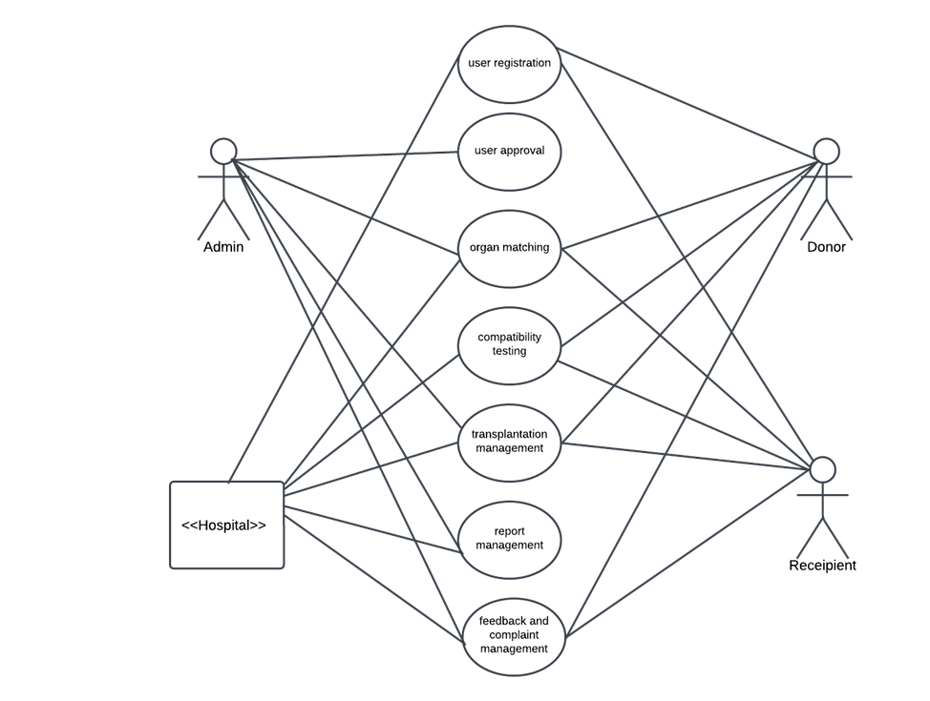
U
S
E
C
A
S
E

Slide 31
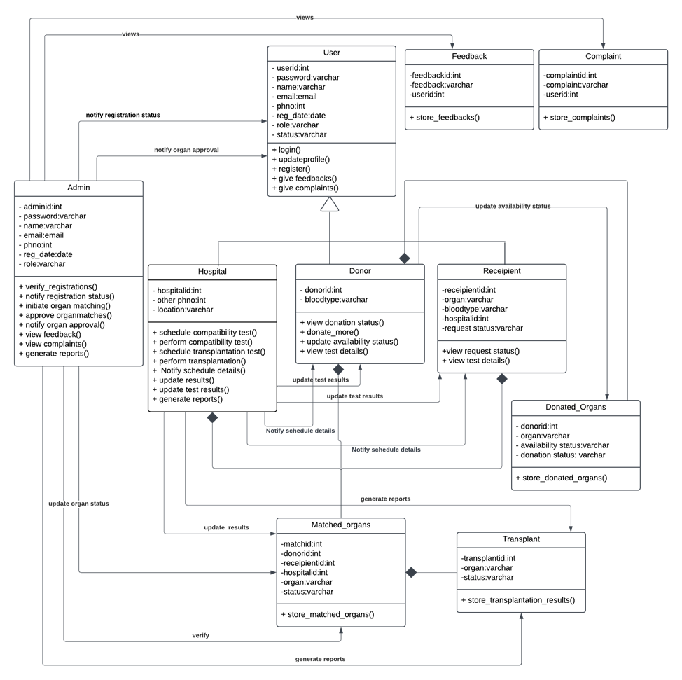
CLASS
DIAGRAM

Slide 32
SEQUENCE
DIAGRAMS

Slide 33
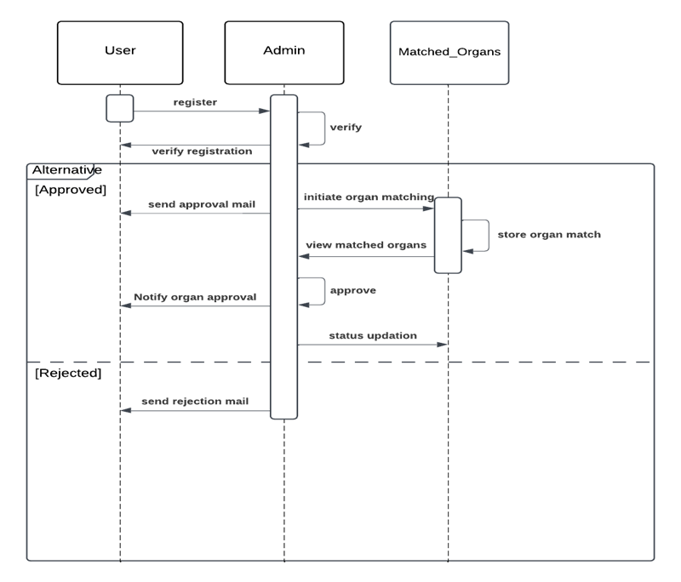
ORGAN
Matching

Slide 34
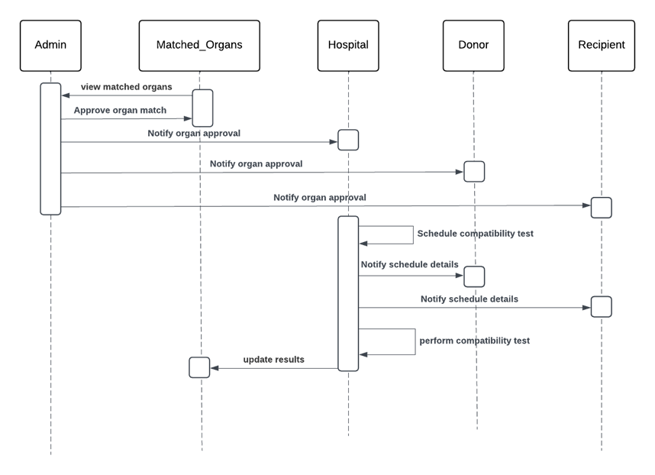
Compatibility
Test

Slide 35
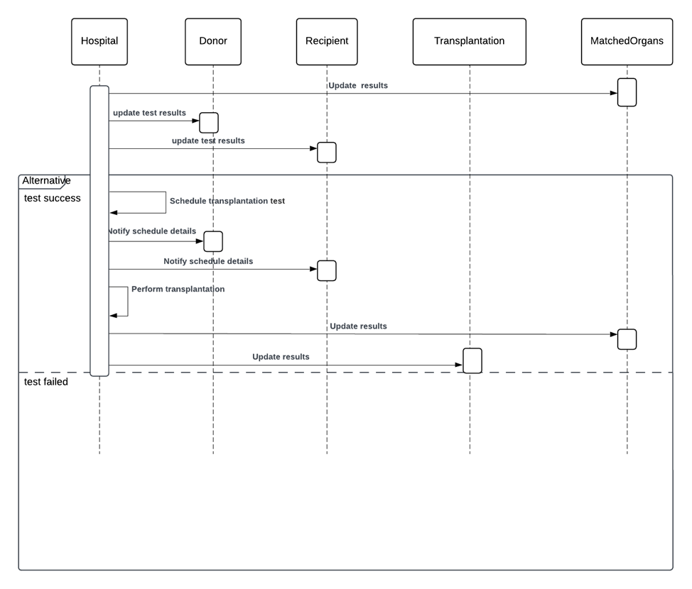
Transplantation
Module

Slide 36
ACTIVITY
DIAGRAMS

Slide 37
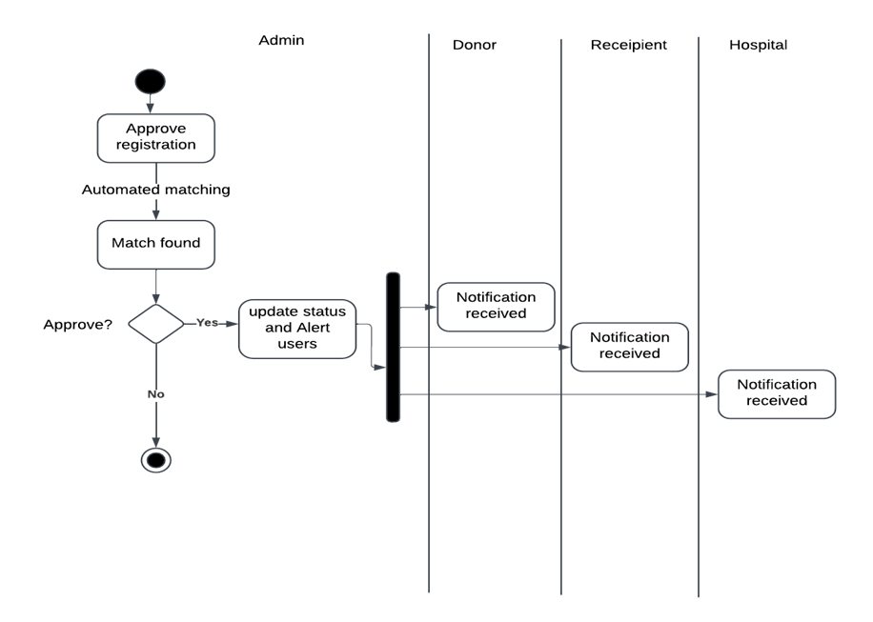
ORGAN
MATCHING

Slide 38
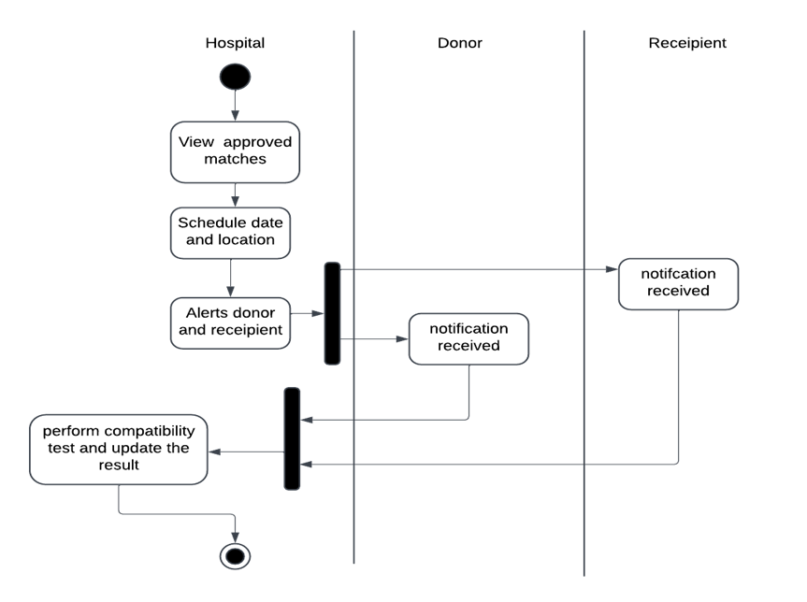
Compatibility
Test

Slide 39
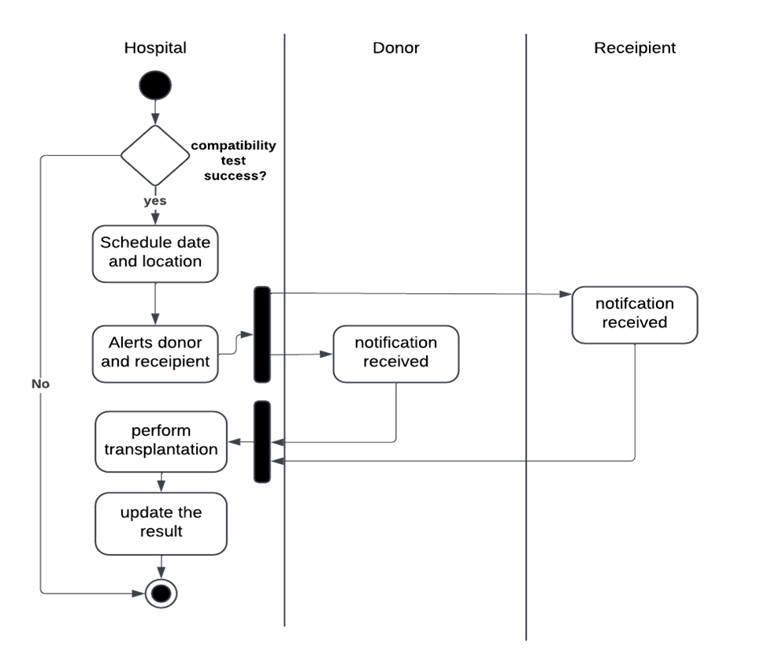
Transplantation
Module

Slide 40
Thank you!

Slide 41
BUSINESS
RULES

Slide 42
Registrations for Donors, Recipients, and Hospitals must be reviewed and approved by the Admin before granting access to the system.
Donors must provide explicit consent for organ donation during registration.
Consent can be revoked at any time before a match is approved by the Admin.
Recipients must provide valid medical records during registration to justify their request for an organ.
Priority will be given based on medical urgency, compatibility, and waiting time.

Slide 43
Matches must be reviewed and approved by the Admin before proceeding to compatibility tests.
Only verified hospitals can perform compatibility tests and transplantation procedures.
Admin must review all registrations (Donors, Recipients, Hospitals) within 24–48 hours of submission.
Complaints must be addressed by the Admin promptly and updates provided to the complainant.

Slide 44
Feasibility Study

Slide 45
Technical Feasibility
Frontend: Flutter ensures seamless cross-platform compatibility; Dart provides responsive UI and smooth performance.
Backend: Node.js enables fast, scalable server-side logic and organ matching algorithms via RESTful APIs.
Database: MongoDB offers flexible, scalable, and efficient data management for donor/recipient profiles and transaction logs.

Slide 46
Ecnomic Feasibility
Open-source technologies (Flutter, Node.js, MongoDB) reduce licensing costs.
Automation lowers administrative expenses and saves time.
Initial investment is justified by long-term cost optimization.

Slide 47
Operational Feasibility
Intuitive UI ensures a consistent user experience across mobile and web.
Automates organ matching.
Enhances trust and transparency through notifications and secure data management.

Slide 48
SYSTEM ENVIRONMENT

Slide 49
Hardware Environment
1.Client Devices:
a.Smartphones and PCs for donors, recipients, and hospital staff.
b.Minimum: Dual-core processor, 4GB RAM, 500MB storage.
2.Server Requirements:
a.High-performance server with the following:
i. Quad-core processor or higher.
ii. 16GB RAM minimum.
iii. 1TB storage with SSD for fast data access.
iv. Reliable internet connectivity for seamless operations.
3.Networking:
a.Secure, high-speed network for communication between client devices and the server.

Slide 50
Software Environment
1.Frontend: Flutter (Dart Language) for cross-platform mobile and web application development.
2.Backend: Node.js for efficient server-side logic and API handling.
3.Database: MongoDB for scalable, NoSQL-based data management.
4.Server OS: Linux (Ubuntu) for high performance, reliability, and cost-effectiveness.
5.Development Tools:
·Android Studio for Flutter development.
·VS Code for backend development.
·Postman for API testing.
6.APIs & Frameworks: RESTful APIs for frontend-backend communication.

